Slide 1
SKILLSHIFT – CAREER TRANSITION ADVISOR
project work done by GURUSARVESH S

Slide 2
Problem Statement
Many students and professionals are confused about choosing the right career path
Lack of guidance based on skills and market demand
Our system solves this by providing data-driven career recommendations
2. Objective
To build an AI-based Career Advisor system
To suggest suitable career paths based on user profile
To identify skill gaps and guide users on what to learn next

Slide 3
Abstract
* Addresses the challenge of aligning existing skills with evolving industry demands by providing AI-based, personalized career recommendations for students and professionals.
* Collects and preprocesses user data (education, skills, experience, interests), applies TF-IDF for skill vectorization, label encoding for categorical data, and combines features for model input.
* Uses a Random Forest Classifier to predict suitable career paths and performs skill gap analysis, providing outputs like required skills, salary range, and market demand.
* Delivers insights through a web-based interface, enabling data-driven career planning, upskilling, and smooth transition to high-demand, technology-driven roles.

Slide 4
Introduction
AI Career Advisor helps users find career paths using machine learning
Target students and professionals from fields like engineering and finance
Analyzes education , Skills and experience for personalized advice
Bridges the gap between current skills and tech roles like data analytics

Slide 5
Existing System
AI-driven career guidance systems use machine learning and NLP to analyze education, skills, interests, and experience for career recommendations, as seen in Scopus-indexed research.
Technical Approaches:Random Forest (up to 88% accuracy), deep learning models like LSTM and RNN, and hybrid models (Random Forest, Naive Bayes, neural networks) with TF-IDF for unstructured skill data.
Core Features: Evaluate academic performance, skills, experience, and interests, include skill gap analysis, and sometimes use chatbots, but are mostly limited to general guidance.
System Architecture: Predominantly web-based, using MERN stack or NLP techniques like BERT embeddings, enabling real-time and scalable recommendations, mainly for students.
Target Users: Primarily students and fresh graduates, with limited support for working professionals and cross-domain career transitions.
Limitations & Summary:Systems are domain-specific and student-focused, lacking personalized cross-domain guidance, real-time market insights, salary data, and skill translation, highlighting the need for more comprehensive career mobility solutions.

Slide 6

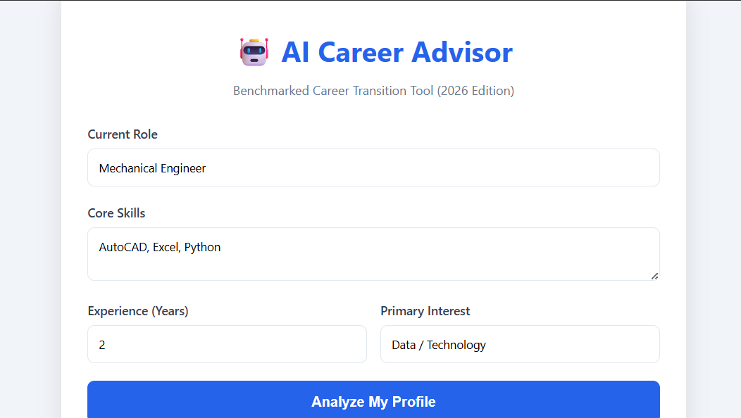
Proposed System : Input Design
Users enter education level (e.g., Bachelors , Masters) using dropdown
Specialization options include CS, Finance, Engineering, etc.
Skills are entered as comma-separated text (e.g., Python, SQL)
CGPA/percentage and career interest fields complete the profile
Fig:1
Fig:2

Slide 7
Proposed System
Intelligent Career Recommendation System
The system uses a machine learning model (Random Forest) to analyze user inputs such as education, specialization, skills, and experience to recommend the most suitable career paths like Data Analyst or ML Engineer.
Data Preprocessing & Feature Engineering
User-provided skills are converted into numerical form using TF-IDF, while categorical inputs like education and domain are encoded using label encoding to make them suitable for model prediction.
Skill Gap Analysis Mechanism
The system compares the user’s current skills with the required skills for the recommended job role and identifies missing skills, helping users understand what they need to learn.
User-Friendly Web Interface
The platform includes signup/login authentication and an interactive dashboard where users can input their details and receive results in a clean, structured card format.
Insightful Output with Market Trends
The system not only suggests career paths but also provides additional insights like required skills, market demand (High/Medium), and estimated salary range, making the recommendations practical and actionable.

Slide 8
Machine learning
Random Forest for Career PredictionThe system uses a Random Forest Classifier to predict the most suitable career path based on user inputs, improving accuracy by combining multiple decision trees.
TF-IDF for Skill ProcessingUser-entered skills are converted into numerical vectors using TF-IDF, which helps the model understand the importance of each skill.
Label Encoding of Categorical DataInputs like education level, specialization, and career labels are transformed into numerical form using Label Encoding for model compatibility.
Feature Integration using NumPySkill vectors (TF-IDF) are combined with other features like education, specialization, and CGPA to create a complete feature set for prediction.
Prediction with Skill Gap AnalysisThe model predicts a career, and a rule-based method identifies missing skills by comparing user skills with required skills for the predicted role.

Slide 9
Proposed System: Form Design
Signup form includes full name, username, and password (with hashing)
Login form verifies username and password using MySQL
Dashboard form uses grid layout for profile inputs
Responsive UI with blue theme and proper error handling

Slide 10
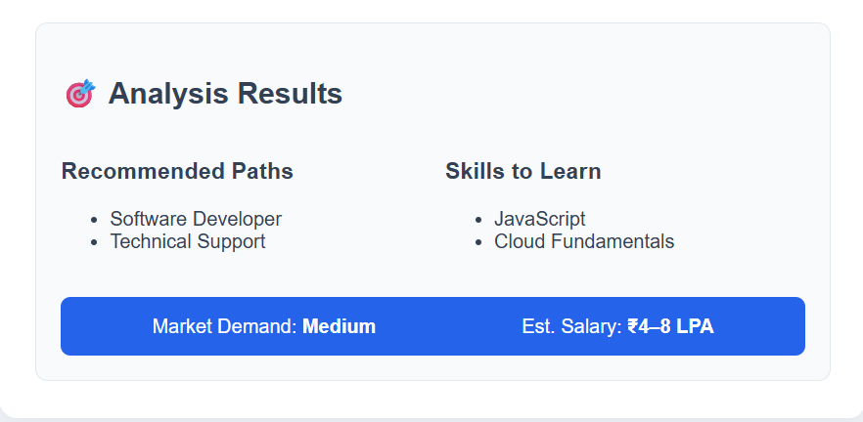
Proposed System: Output Design
Displays recommended career paths (e.g., Data Analyst, ML Engineer)
Lists required skills based on gap analysis
Shows market demand (High / Medium) and salary range (e.g., 4–8 LPA)
Results are presented in a structured card format
Fig:3

Slide 11
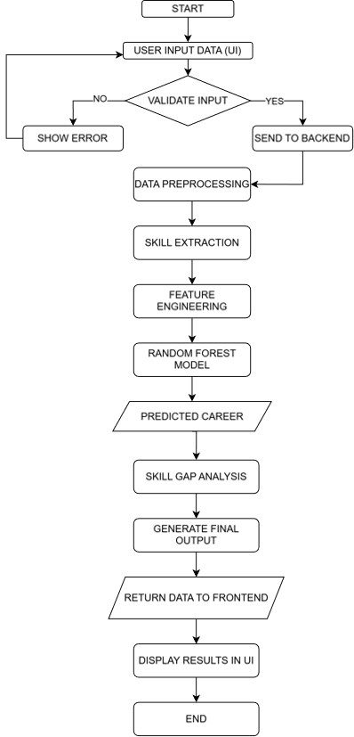
Data Flow Diagram
User input is preprocessed using TF-IDF (for skills) and label encoding
Processed data is fed into a Random Forest model
Skill gap is calculated by comparing with required job skills
Output includes career recommendation, skills, demand, and salary

Slide 12
Conclusion
System enables career transition using data-driven insights
Supports users from multiple domains
Improves employability through personalized suggestions
Future scope: real-time job data integration and resume parsing
Combines machine learning backend with user-friendly web interface

